Slide 1
Coarse Frequency Translation
Frequency Estimation via an FFT
Özün Yiğit Bayram
Yahya Ekin

Slide 2
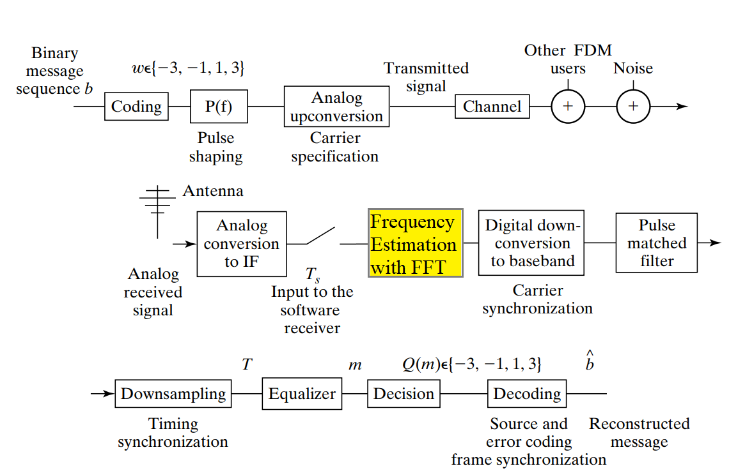
System Diagram

Slide 3
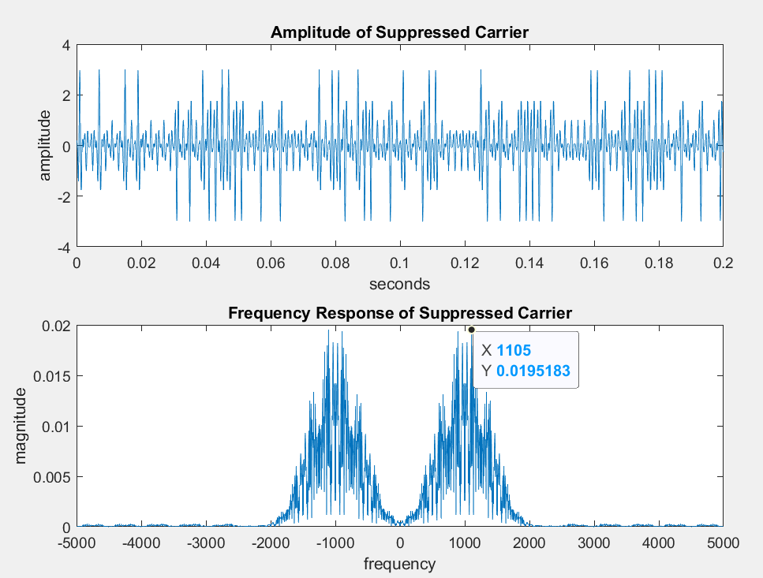
Frequency Estimation via an FFT
The direct estimation of carrier frequency consist of only one step
1-Taking the FFT of the received signal.
However this process
introduces errors in
frequency estimating.

Slide 4
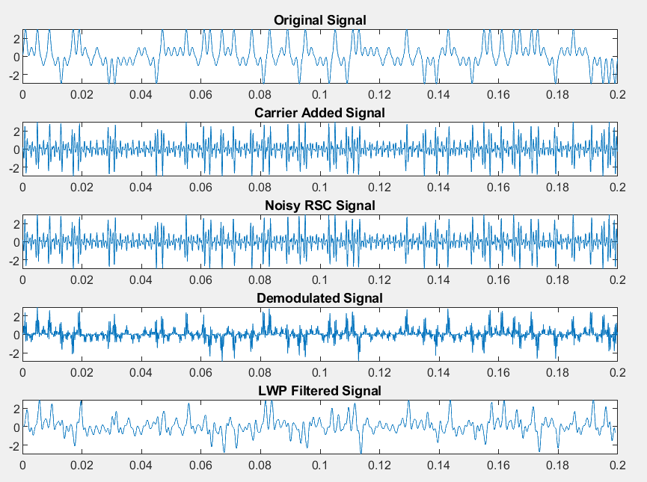
What happens if estimated frequency is wrong ?
In this case, carrier frequency is shifted 200 Hz. Therefore the demodulated signal with mismatched carrier frequency results in distortion at lowpass filtered signal. The resulting normalized symbol error is: 0.6300

Slide 5
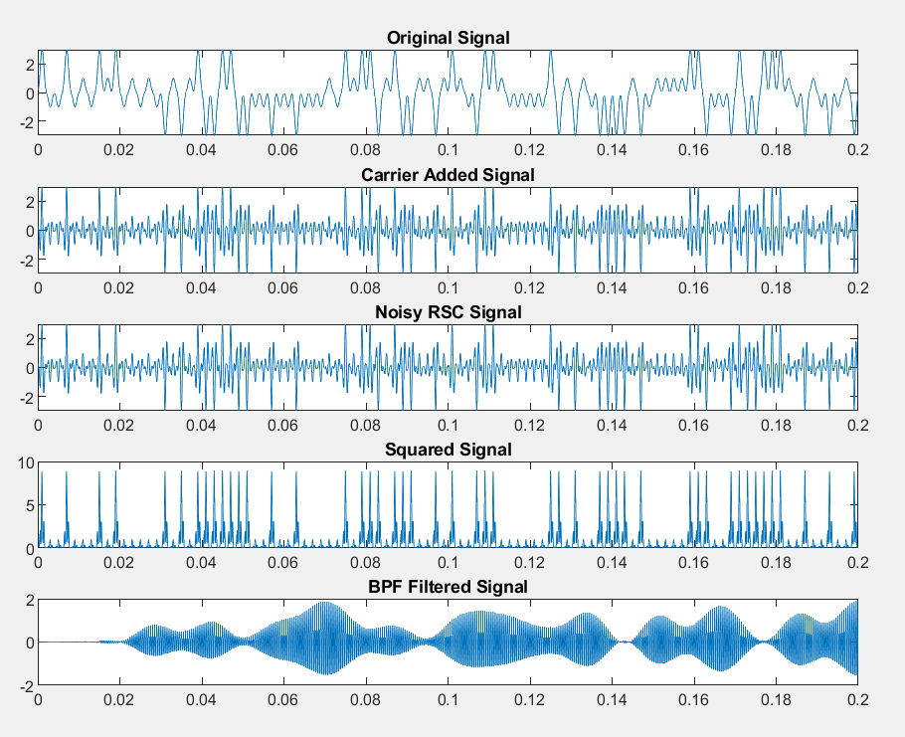

How to estimate frequency precisely ?
To estimate frequency precisely, these preprocessing steps are applied:
1-Squaring nonlinearity
2-Bandpass filtering at twice of the known carrier frequency

Slide 6
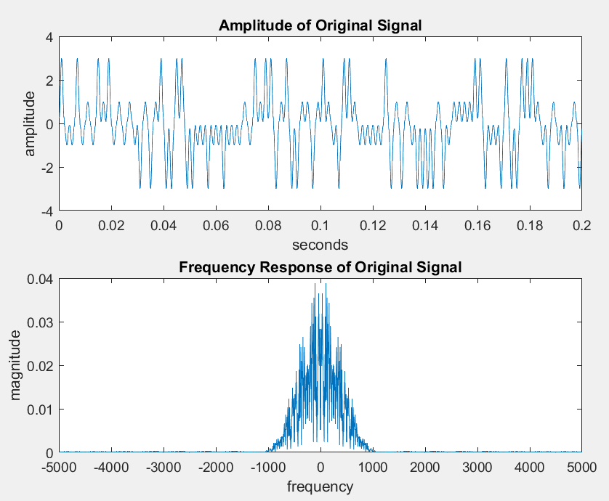
Step 1: Generating random signal, PAM modulation, Pulse Shaping
Random message is generated
Random message modulated using 4-level pulse amplitude modulation (-3,-1,1,3)
Pulse shaping with hamming window.

Slide 7
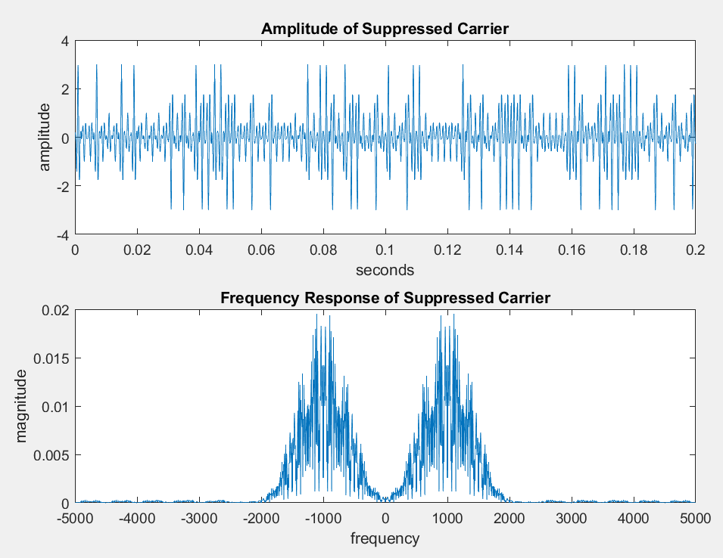
Step 2: Adding Carrier at fc
s(t)=Baseband Signal x cos(2*pi*fc*t)
We are modulating our carrier on our communication frequency.

Slide 8

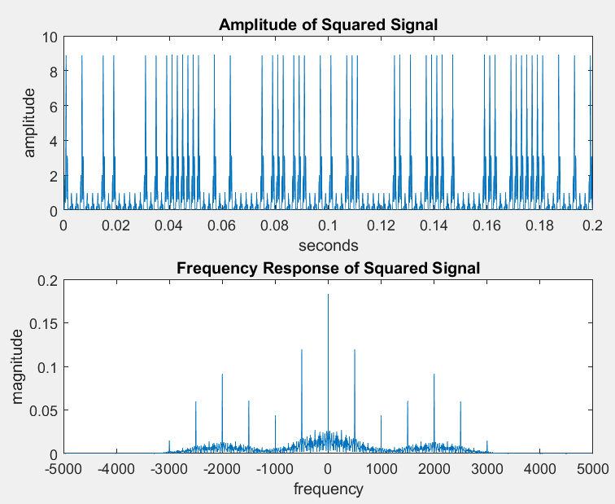





Step 3: Adding AWGN noise, Receiving modulated Signal, Squaring
The squared signal can be expressed as below by using the trigonometric identity:
Due to variatons on s(t) term, then the squared signal equals to:

Slide 9
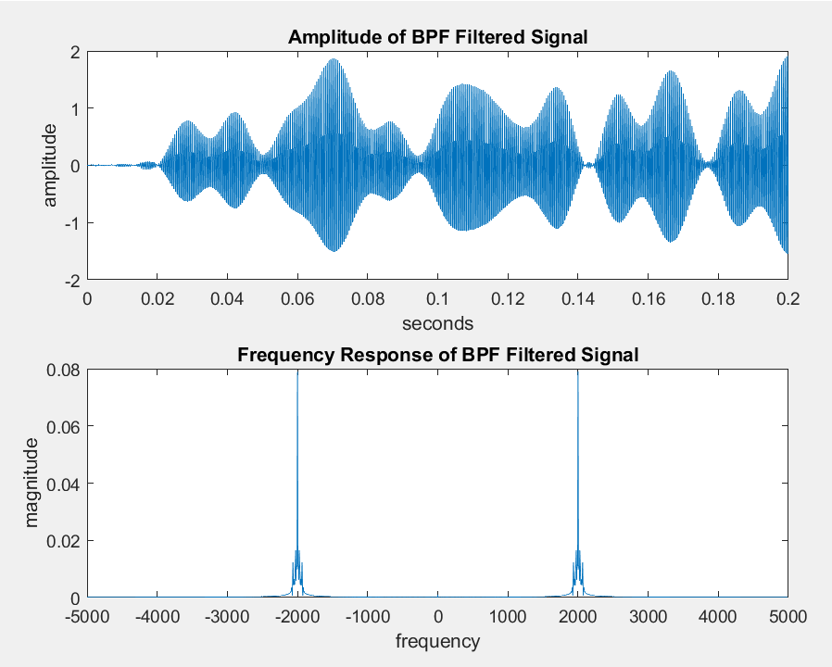

Step 4: Bandpass Filtering
Banpass filter centered at 2fc removes the frequencies due to squaring and only remains frequencies at 2fc as on the right:
Frequency is doubled
Phase is doubled
Phase change due to BPF added

Slide 10
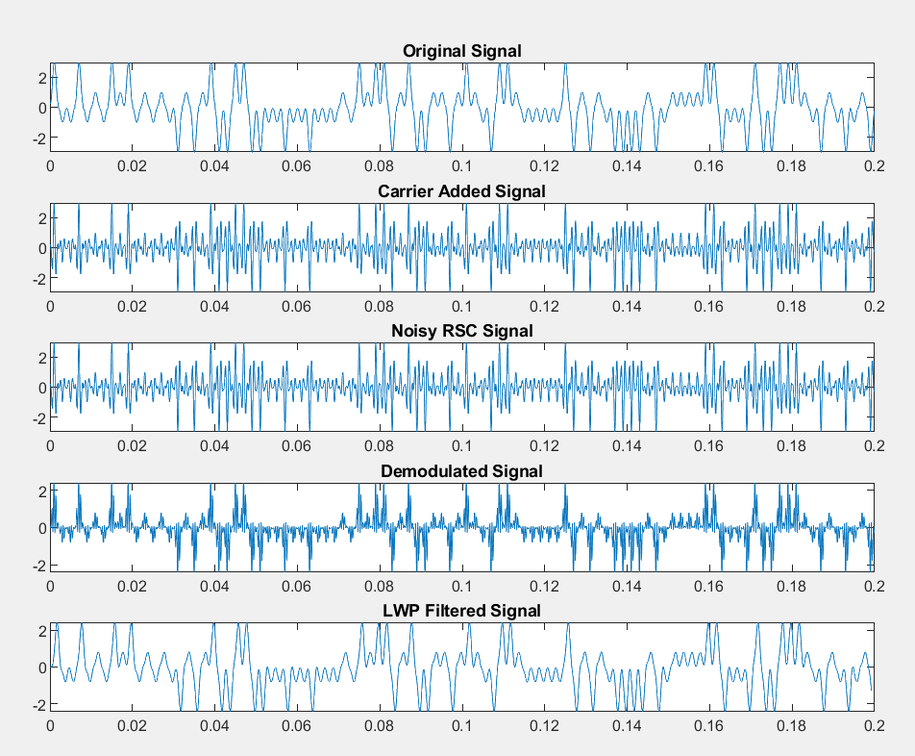
Step 5: Demodulating with Estimated Carrier Frequency, Lowpass Filtering,Timing Adjustment
Demodulation is performed using the estimated carrier frequency to retrieve the original signal.
A low-pass filter at the estimated fc is applied, which introduces a timing error.
Correcting this error involves calculating the group delay and adjusting the time vector, resulting in a signal closely resembling the original.

Slide 11
Performance: Symbol Errors
Symbol Error is calculated by comparing received symbols and generated symbols. When error occurs, error variable is increased and then normalized with dividing to length of received symbols.
Frequency Estimation per Offset | Frequency Offset | Normalized Symbol Error
1000 | 0 | 0.0050
1030 | 30 | 0.0040
1023 | 45 | 0.5850
982.5 | 90 | 0.6240
1010 | 135 | 0.6310
1010 | 260 | 0.7590

Slide 12
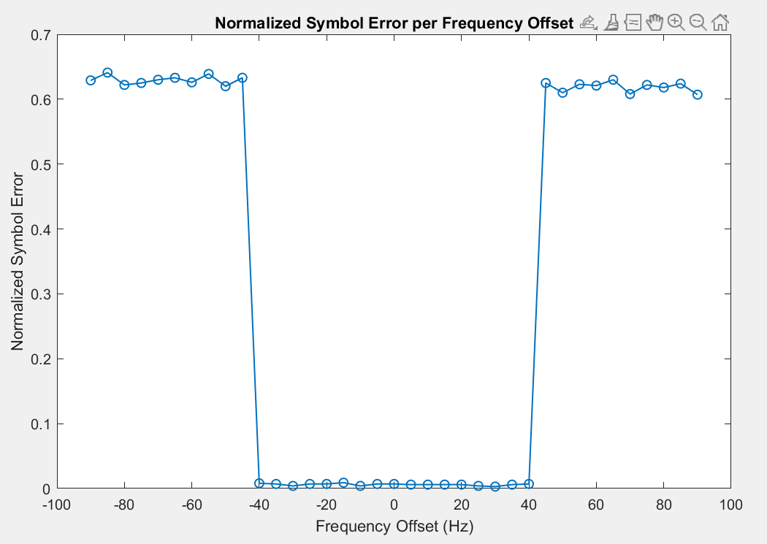
Normalized Symbol Error per Frequency Offset
In order to test our communication system, firstly, we added frequency offset to our carrier frequency. Then we calculated the normalized symbol error for trial times per frequency offset to achieve more statistically true results. In our case number of trial is 10. The symbol length is 100. AWGN Noise is 100dB. (Almost no noise).
So, frequency estimation method can detect the offset band of -40 to +40 Hz without a significant error. If the shift in frequency exceeds that band, then the symbol error introduces.

Slide 13
Cluster Variance
SNR(dB) | Cluster Variance (-3) | Cluster Variance (-1) | Cluster Variance (1) | Cluster Variance (3) | Normalized Symbol Error
100 | 0.7809 | 0.3713 | 0.6484 | 0.5797 | 0.0100
50 | 0.9718 | 1.8781 | 1.4868 | 1.3988 | 0.0100
20 | 1.5480 | 1.8146 | 0.9523 | 1.2842 | 0.0100
0 | 2.1127 | 1.5328 | 1.2847 | 2.2884 | 0.2500
-10 | 7.2814 | 6.8625 | 3.1739 | 4.5577 | 0.6800

Slide 14
Conclusion
To summarize:
Random PAM symbols with variance 5 is generated, pulse shaped with hamming pulse and modulated with suppressed carrier.
The modulated signal is subjected to AWGN noise.
The received signals is preprocessed. Then carrier frequency is estimated with FFT.
Received signal is demodulated with estimated carrier frequency, then correlated with hamming pulse to recover PAM symbols.
The Normalized Symbol Error is calculated.
If the carrier frequency is shifted in the band of -40Hz to +40Hz band, then carrier frequency can be estimated. If it is not in this band, symbol error occured.

Slide 15
Thanks for Listening

